Slide 1
Distributed Hash-breaker Concurrent and distributed Systems | AA 2019/20
Filippo Scotto, Luigi Treccozzi

Slide 2

Analisi progetto diapositiva 2
Outline
IMPLEMENTATIONS
SPECIFICATIONS
DHB
TEST
TECHNOLOGIES USED

Slide 3
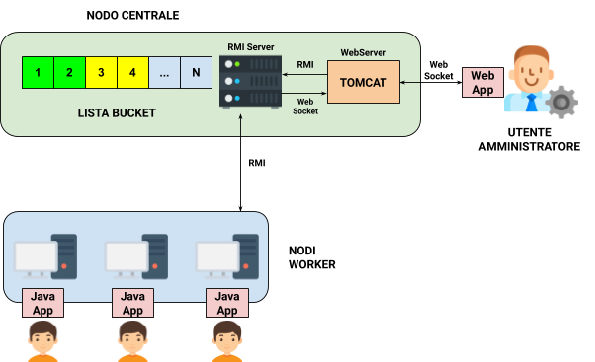
Analisi progetto diapositiva 3
Specifications
DHB is a distributed application that implements a distributed attack against a Hash function, namely SHA-2
It makes available an interface through which users can join the attack
At the server side, administrator can set the plaintext to break and monitor the attack progress over time

Slide 4
Analisi progetto diapositiva 3
Specifications
Administrator: through WebApp he can launch the attack, providing the plaintext to break, monitor the status of the attack
Worker(s): Users that want to join the attack. Through GUI they are requested to provide a username. Upon registering they are given a bucket, that is, a set of plaintexts to analyze. By Analyze a bucket we mean that a user compute the hash function of all the plaintexts in the bucket that has been assigned in order to find a match with the hash provided by administrator

Slide 5



Analisi progetto diapositiva 3
Technologies used
JDK-11.0.2 (Swing, RMI)
MAVEN 3.6.1
APACHE TOMCAT 9.0.27

Slide 6
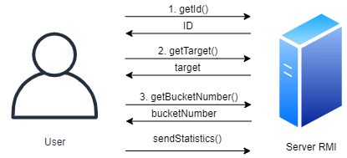
Analisi progetto diapositiva 4
Client-Server Interaction
Java Swing
RMI
Multi-thread
xchart-3.6.0 [1]

Slide 7
Analisi progetto diapositiva 4
Administrator Dasboard
Java Swing
RMI
Multi-thread
xchart-3.6.0 [1]

Slide 8
Thanks

